Slide 1
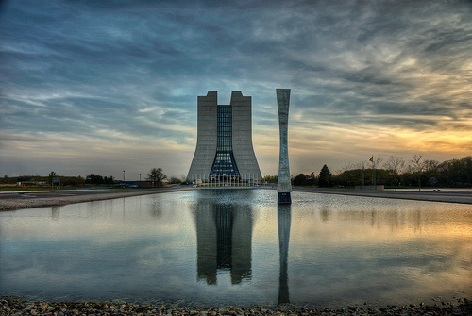

The Electron Cloud And Secondary Electron Yield
Tom Schmit

Slide 2
The Electron Cloud
Fermilab and the intensity frontier
Accelerators are approaching a new regime in intensity
Many difficulties are associated with increased intensity
Increased intensity results in electron cloud formation
Formation of an electron cloud results in instability
Very hard problem to solve analytically
Not well understood

Slide 3
Secondary Electron Yield
Combat electron cloud formation by reducing secondary electron yield
Test different materials for use in beam line
Must be vacuum compatible
Durable
Have a low SEY
Use test stand to treat and measure different samples

Slide 4
The Setup
Sample
Electron Gun
Picoammeter
I
HV Supply
Sample Bias

